Slide 1
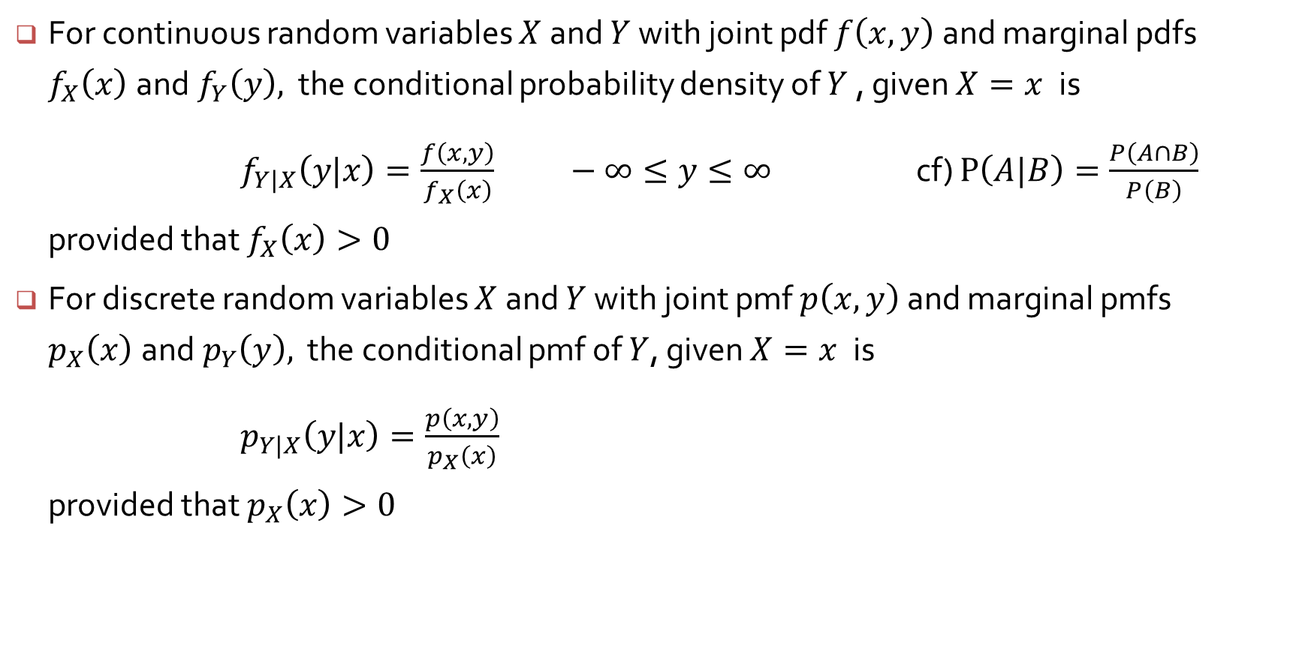
Conditional distributions
For continuous random variables $X$and $Y$ with joint pdf $f\left(x, y\right)$ and marginal pdfs ${f_{X}\left(x\right) \text{and} f}_{Y}\left(y\right),$ the conditional probability density of $Y$, given $X=x$is
$f_{Y|X}\left(y|x\right)=\frac{f\left(x, y\right)}{f_{X}\left(x\right)} −∞≤y≤∞$ cf) $P\left(A|B\right)=\frac{P\left(A∩B\right)}{P\left(B\right)}$
provided that $f_{X}\left(x\right)>0$
For discrete random variables $X$and $Y$ with joint pmf $p\left(x, y\right)$ and marginal pmfs ${p_{X}\left(x\right) \text{and} p}_{Y}\left(y\right),$ the conditional pmf of $Y$, given $X=x$is
$p_{Y|X}\left(y|x\right)=\frac{p\left(x, y\right)}{p_{X}\left(x\right)}$
provided that $p_{X}\left(x\right)>0$

Slide 2
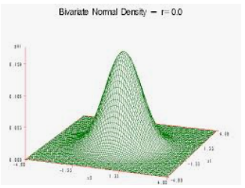
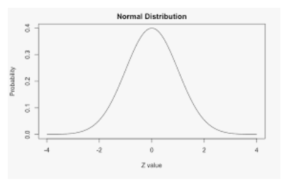
Cross Section at X=x

Slide 3
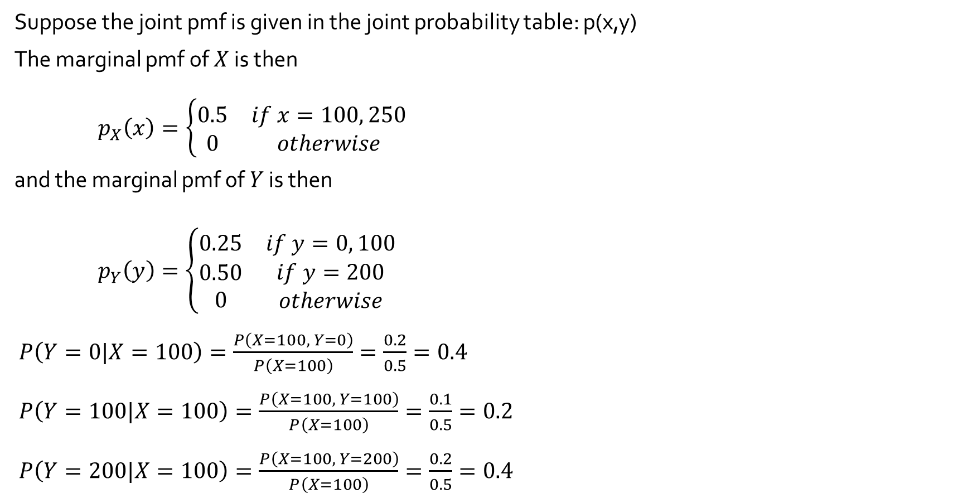
Two Discrete Random Variables - Examples
Suppose the joint pmf is given in the joint probability table: p(x,y)
The marginal pmf of $X$ is then
$p_{X}\left(x\right)=\left\{\begin{matrix}0.5 & if x=100, 250 \\ 0 & otherwise\end{matrix}\right.$
and the marginal pmf of $Y$ is then
$p_{Y}\left(y\right)=\left\{\begin{matrix}0.25 & if y=0, 100 \\ \begin{matrix}0.50 \\ 0\end{matrix} & \begin{matrix}if y=200 \\ otherwise\end{matrix}\end{matrix}\right.$
$P\left(Y=0|X=100\right)=\frac{P\left(X=100, Y=0\right)}{P\left(X=100\right)}=\frac{0.2}{0.5}=0.4$
$P\left(Y=100|X=100\right)=\frac{P\left(X=100, Y=100\right)}{P\left(X=100\right)}=\frac{0.1}{0.5}=0.2$
$P\left(Y=200|X=100\right)=\frac{P\left(X=100, Y=200\right)}{P\left(X=100\right)}=\frac{0.2}{0.5}=0.4$
y
 |  | 0 | 100 | 200
x | 100 | 0.20 | 0.10 | 0.20
 | 250 | 0.05 | 0.15 | 0.30

Slide 4
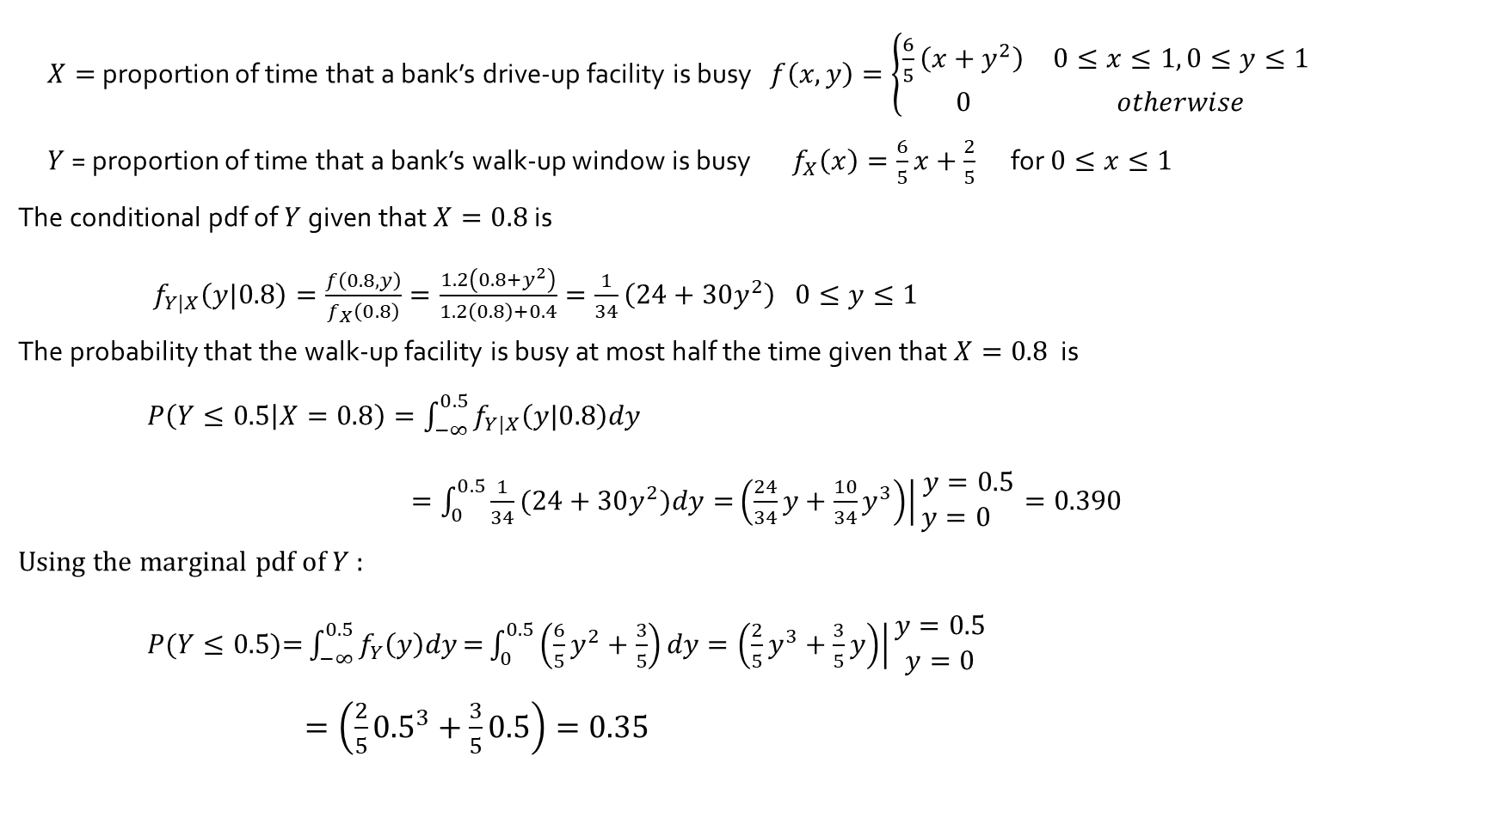
Example 5.12 (Reconsider Example 5.4)
$X=$ proportion of time that a bank’s drive-up facility is busy $f\left(x, y\right)=\left\{\begin{matrix}\frac{6}{5}\left(x+y^{2}\right) & 0≤x≤1, 0≤y≤1 \\ 0 & otherwise\end{matrix}\right.$
$Y$ = proportion of time that a bank’s walk-up window is busy $f_{X}\left(x\right)=\frac{6}{5}x+\frac{2}{5}$ for $0≤x≤1$
The conditional pdf of $Y$given that $X=0.8$ is
$f_{Y|X}\left(y|0.8\right)=\frac{f\left(0.8, y\right)}{f_{X}\left(0.8\right)}=\frac{1.2\left(0.8+y^{2}\right)}{1.2\left(0.8\right)+0.4}=\frac{1}{34}\left(24+30y^{2}\right) 0≤y≤1$
The probability that the walk-up facility is busy at most half the time given that $X=0.8$ is
$P\left(Y≤0.5 | X=0.8\right)=\int_{−∞}^{0.5}{f_{Y|X}\left(y|0.8\right)dy}$
$=\int_{0}^{0.5}{\frac{1}{34}(24+30y^{2})dy=}\left.\left(\frac{24}{34}y+\frac{10}{34}y^{3}\right)\right|\begin{matrix}y=0.5 \\ y=0 \end{matrix}=0.390$
Using the marginal pdf of $Y$ :
$P(Y≤0.5\text{)=}\int_{−∞}^{0.5}{f_{Y}\left(y\right)dy}\text{=}\int_{0}^{0.5}{\left(\frac{6}{5}y^{2}+\frac{3}{5}\right)dy}=\left.\left(\frac{2}{5}y^{3}+\frac{3}{5}y\right)\right|\begin{matrix}y=0.5 \\ y=0\end{matrix}$
$=\left(\frac{2}{5}{0.5}^{3}+\frac{3}{5}0.5\right)=0.35$

Slide 5
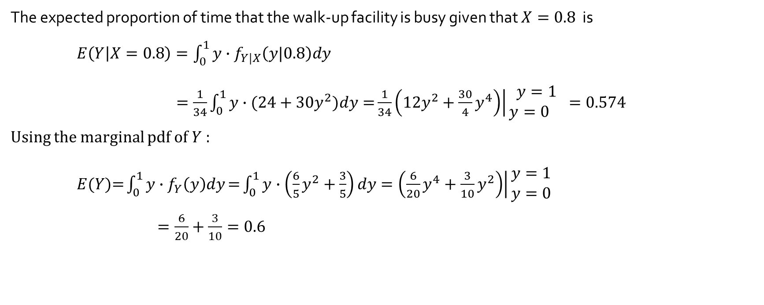
Example 5.12 (Reconsider Example 5.4)
The expected proportion of time that the walk-up facility is busy given that $X=0.8$ is
$E\left(Y | X=0.8\right)=\int_{0}^{1}{{y∙f}_{Y|X}\left(y|0.8\right)dy}$
$=\frac{1}{34}\int_{0}^{1}{y∙(24+30y^{2})dy=}\frac{1}{34}\left.\left(12y^{2}+\frac{30}{4}y^{4}\right)\right|\begin{matrix}y=1 \\ y=0 \end{matrix}=0.574$
Using the marginal pdf of $Y$ :
$E(Y\text{)=}\int_{0}^{1}{y∙f_{Y}\left(y\right)dy}\text{=}\int_{0}^{1}{y∙\left(\frac{6}{5}y^{2}+\frac{3}{5}\right)dy}=\left.\left(\frac{6}{20}y^{4}+\frac{3}{10}y^{2}\right)\right|\begin{matrix}y=1 \\ y=0\end{matrix}$
$=\frac{6}{20}+\frac{3}{10}=0.6$

